Slide 1
The IIP-SARS: Status, Achievements and Challenges
Hilary Ogbonna,
Senior Human Rights Adviser and Secretary of IIP-SARS

Slide 2

Background
The IIP-SARS: A National Panel established by the NHRC in response to the END SARS protests and the NEC Resolution.
9 Member Panel drawn from the judiciary, the Bar, civil society, Government and Youths.
Panel had inaugural sitting in November 2020

Slide 3
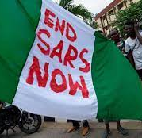
Synopsis of Petitions
297 petitions from 29 states and the Federal Capital Territory (FCT)
  Illegal Arrests and Detention
  Cruel, inhuman and degrading treatment,
  Extra-judicial killing
  Non-payment of judgment debts/awards

Slide 4
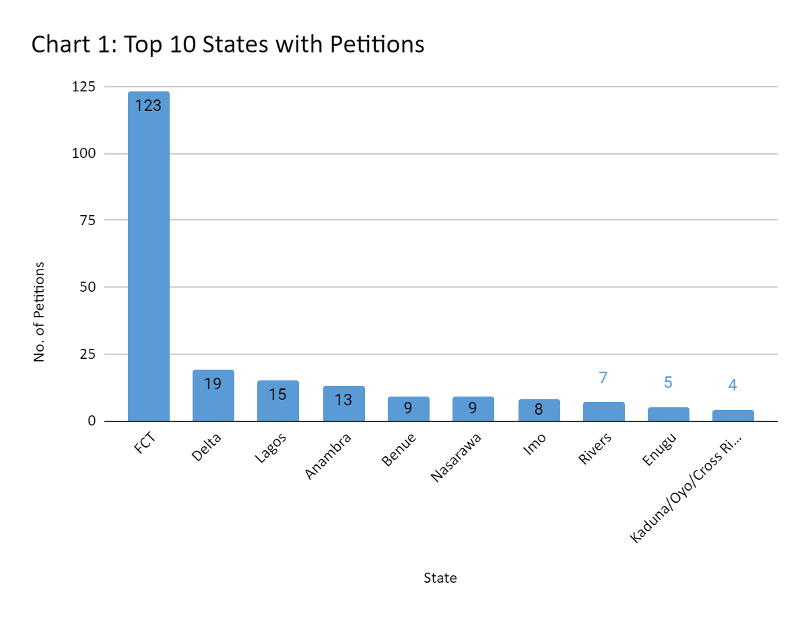

Slide 5
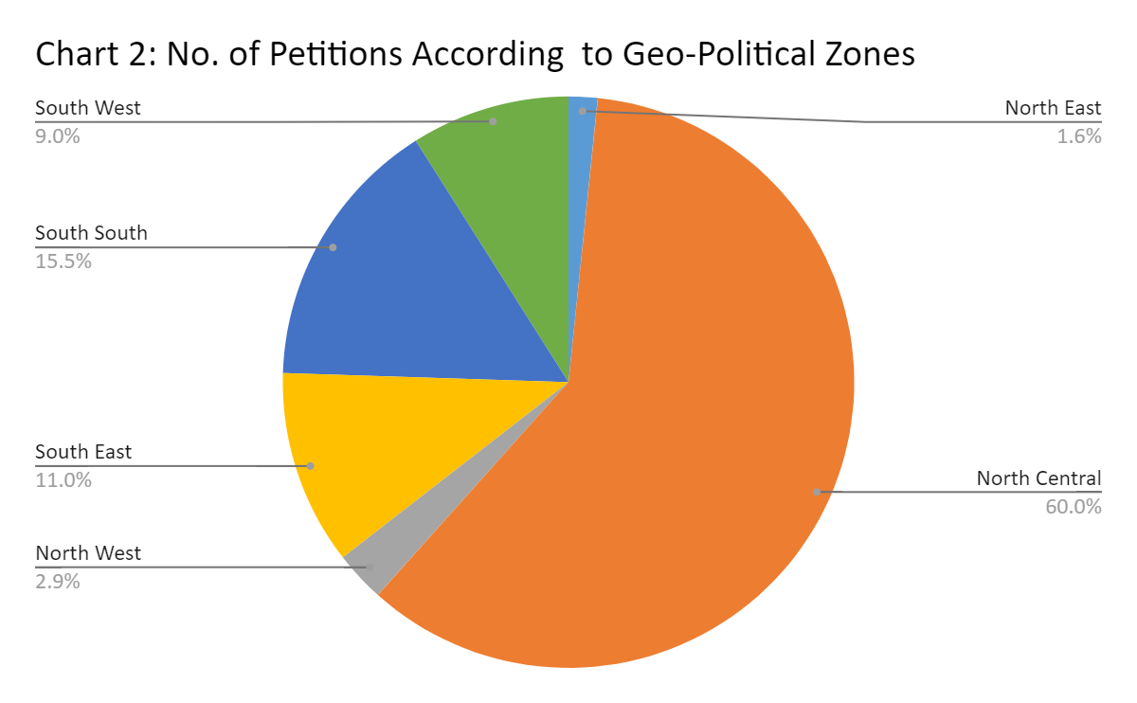

Slide 6
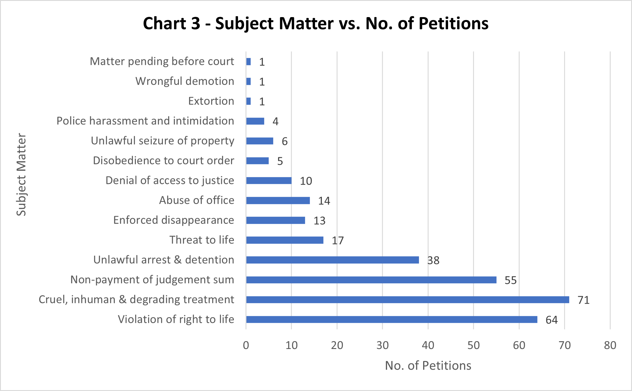

Slide 9
Statistics on Decided Cases
Struck out – 25
Withdrawn – 12
Dismissed – 1
Panel has reached decision in 75 Cases
Compensation has been approved for 20 cases

Slide 10
Awards/Compensation
7 - Extrajudicial Killing and Enforced Disappearance
5 - Torture, Inhuman and Degrading Treatment
5 - Illegal Arrests and Prolonged Detention
3 – Confiscation of Property, Threat to Life

Slide 11
Notes on Justice for Victims
Institutional
  Nigerian Police Force
  Police Service Commission
Prosecutorial
  Office of the Attorney General of the Federation
Compensation
  Government at State and Federal Levels
  NHRC

Slide 12
Challenges
Funding
  To support the Panel’s logistics and operations.
  To support the work of Panel Members and secretariat staff.
  For the payment compensation to victims in concluded petitions.
Operational challenges with the Police.
  Lack of records
  Poor support to the Police Legal Team
  Disobedience to Panel Orders

Slide 13
Next Steps
What happens to the remaining 143 Petitions?
  Panel has adjourned sine die
  There will be no more sittings until funding comes
NHRC will continue to seek for funds to administer the Panel and to compensate victims

